Slide 1

Application of Photochemistry in TEVA Production
October 2021

Slide 2
Content
Summary
knowledge
Tubes comparison
Availability
Concept, LED/Flow results
Mistakes
Online analysis
TEVA Perspective

Slide 3
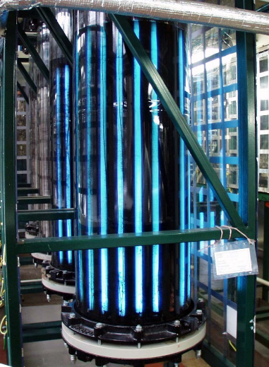
Photochemistry => summary
- More than 30 years in production scale
- production 10t/y
1st gen. - 400 W high pressure Hg lamp (end 1990)
  non selective UV spectrum, high temperature
2nd gen. - 36 W low pressure Hg lamp
    wide UV spectrum, tube production finishing
3rd gen. - 2W LED (narrow spectrum; development 2019)
    high power LEDs, long lifetime
Current Production = 20*100 L reactors with 27 low pressure 1 m tube
Motivation to LED: Hg limitation, sustainable grow

Slide 4
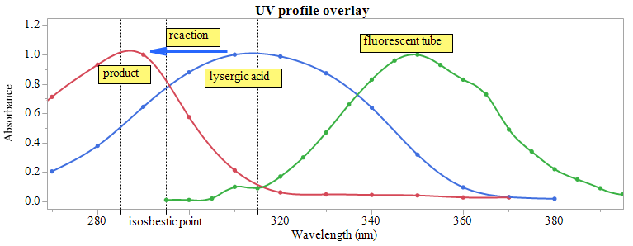
Reaction Knowledge
Quantum yield is about 2
Reaction is almost not dependent on wavelength in range 280 nm - 360 nm
Temperature speed up a little the conversion
Acid concentration is crucial
Mechanical mixing does not influence the conversion

Slide 5
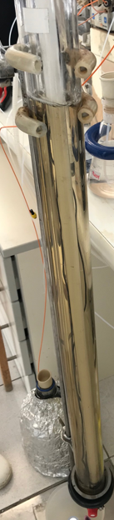

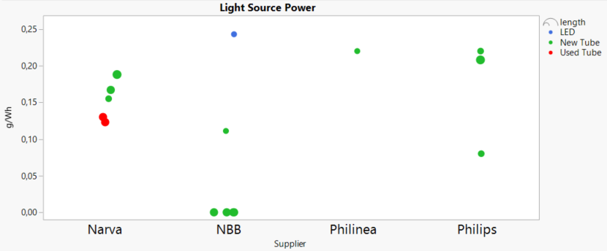
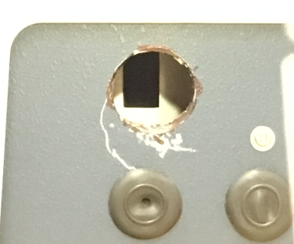
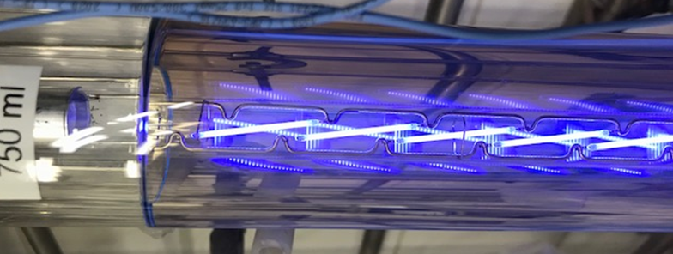
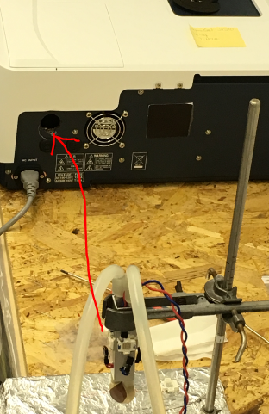
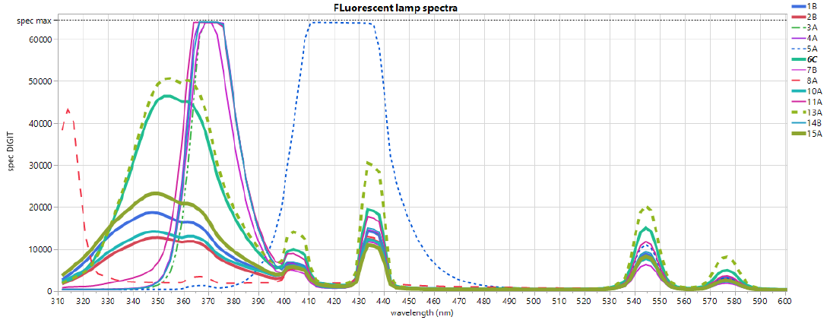
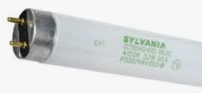
Photochemistry => pioneering LED test Results
LED effectivity is comparable to fluorescent lamp
Tube test
LED
LED tube
Spectrometer modification
Low pressure UV tube

Slide 6
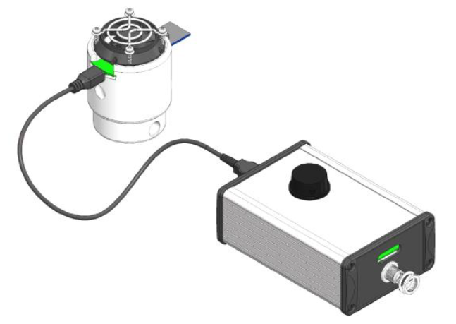
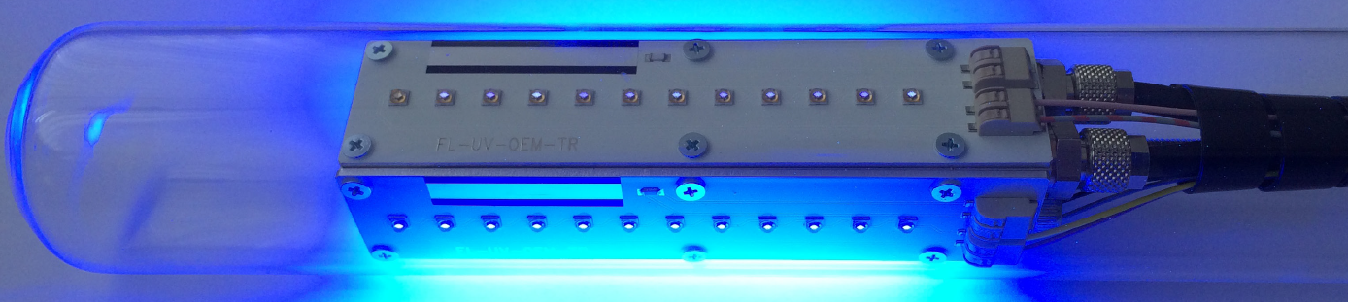
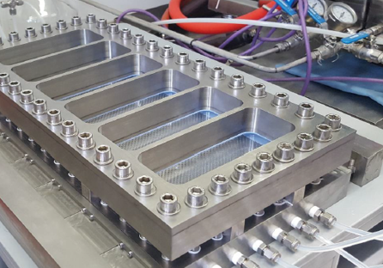
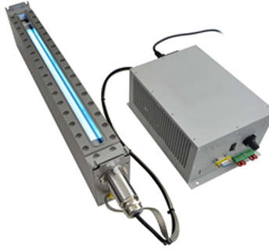
Availability
Peschl - LaborExpo
Heraeus – Excimer 308 nm, Feasibility, Parametrization, Scale-up
Asia Photochemistry Reactor – lab
Vapourtec – lab
….
Decision : Build new in-house photoreactor

Slide 7
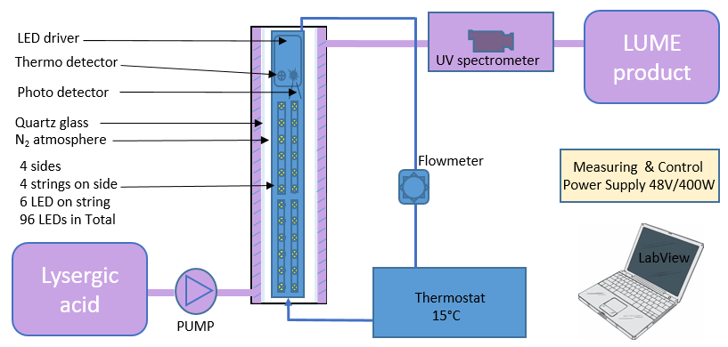
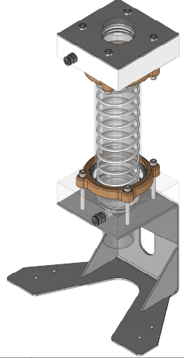
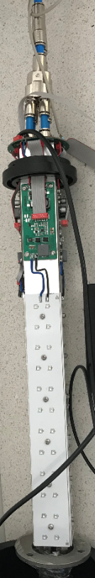
Photochemistry => Concept
Parameters to set up
LA concertation
Residence time (flow)
LED power (Current or Duty time)
LED cooling
Monitoring & Controlling mechanism
Conversion UV detection
LED radiation
LED temperature
Cooling flow
Notes:
Pulsation,

Slide 8
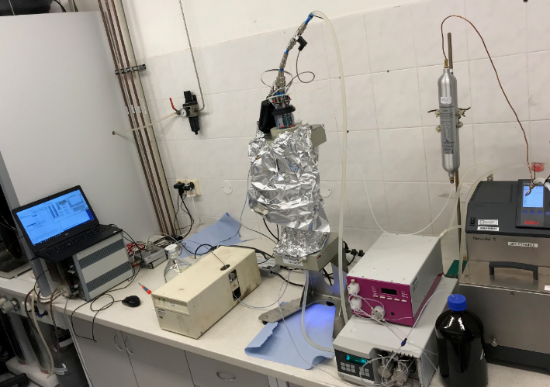
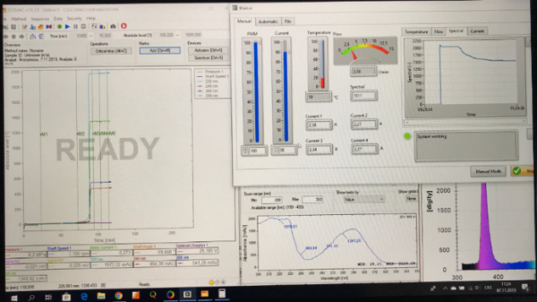
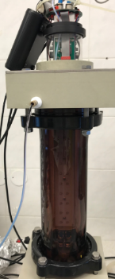
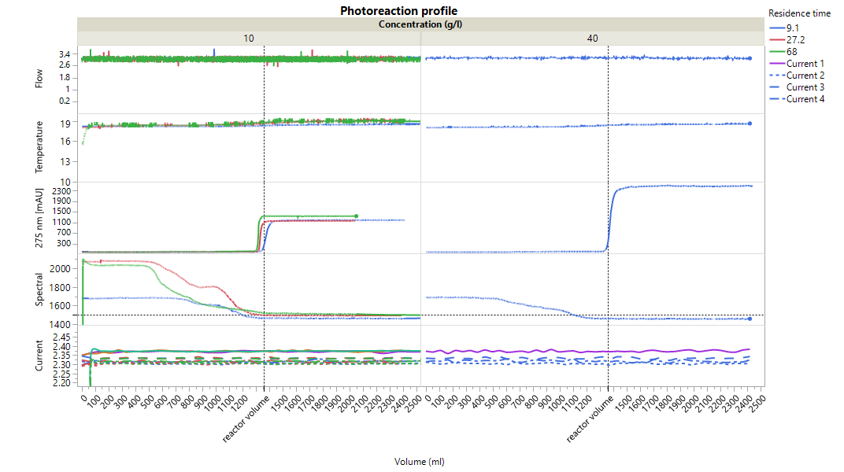
Photochemistry => New reactor, first Results
LED procedure is Robust & Constant -> Flow, Radiation, Current, Temperature, Residence time, No back mixing

Slide 9
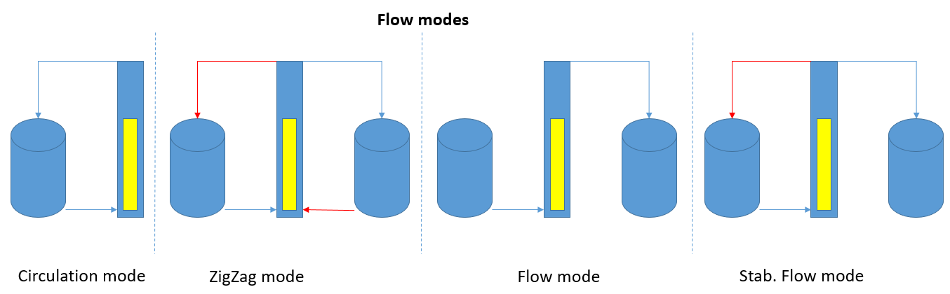
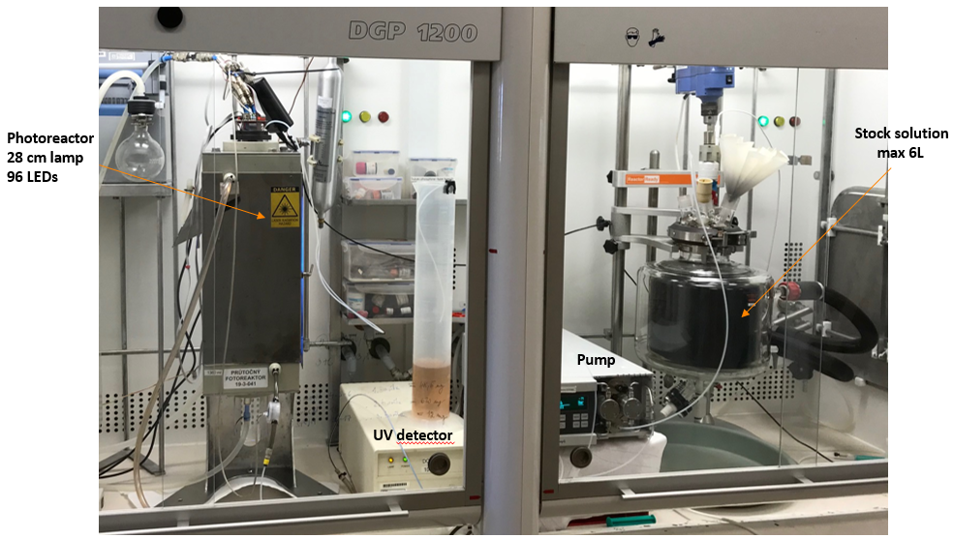
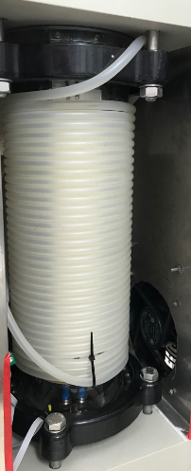
Photochemistry => Scale-Up

Slide 10
Advantages of the proposed system
Ecology safety compliance
Easy increase production capacity according to current market requirements
Higher LED lamps lifetime (14 years versus 6 months)
Estimated capacity: 6 x 1m LED reactor for annual production
Significantly lower area required

Slide 11
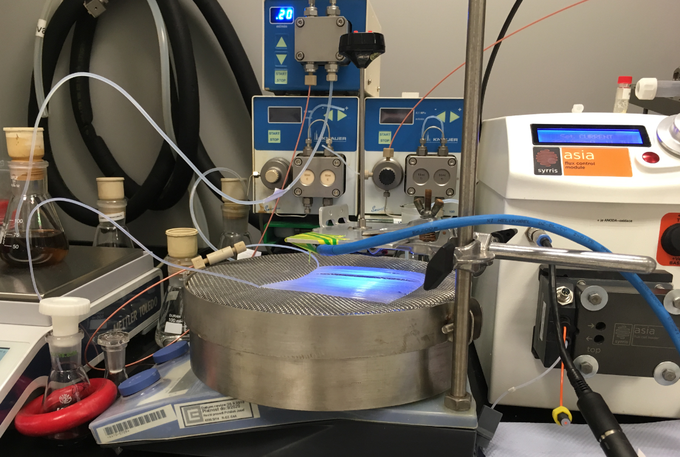
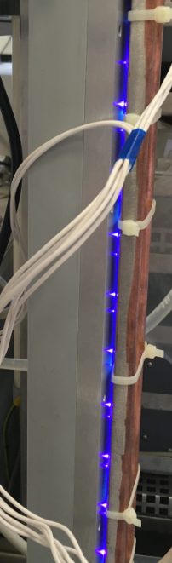
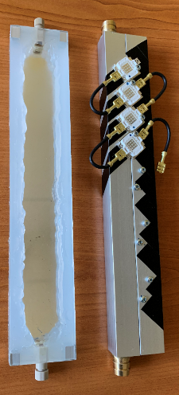
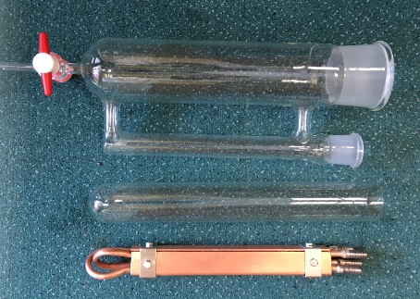
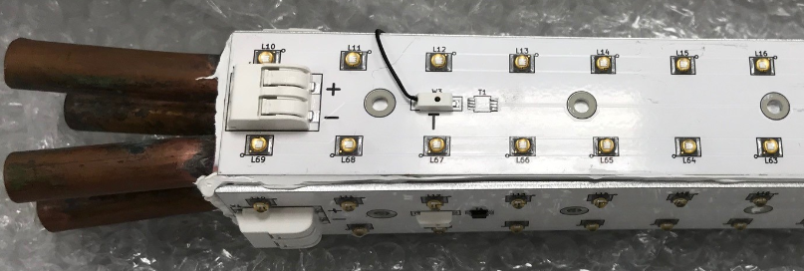
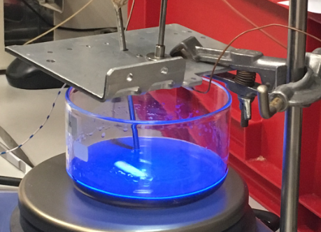
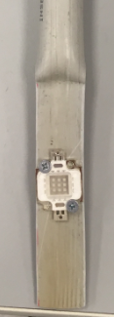
Mistakes
AliExpress, Excimers (Heraeus)
SO2 plasma light source
Cu, 1m
300 LEDs

Slide 12
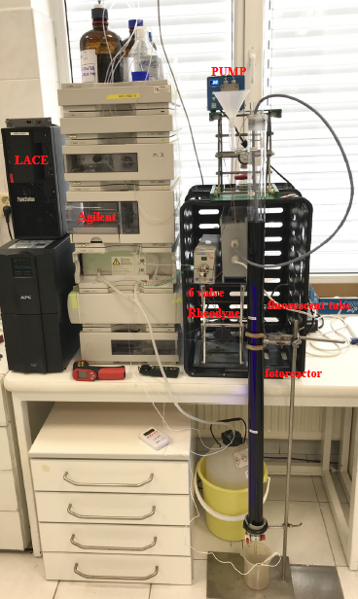
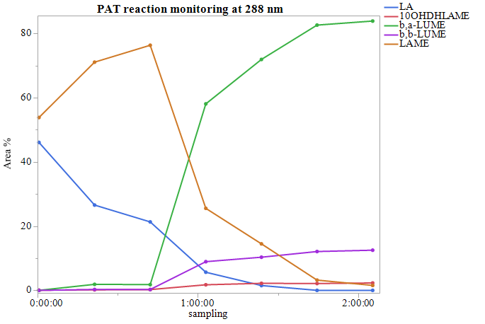
Photochemistry => PAT

Slide 13
TEVA perspective
Covid-19 speed up UV LED development (power, lifetime)
EU Legislative limitation, Tube manufacturer is stopping T8 tube production
Low pressure UV tubes in TEVA store
In-house photoreactor supporting documents prepared for building up
UV tube T8 LED alternative ….

